Slide 1
Project on
Cafeteria Management, DU
Department of Computer Science & Engineering
CSE 2112: Object-Oriented Programming Lab
University of Dhaka
Authors: Group-10
Suraya Jannat Mim (17)
Anisha Tabassum (19)
Jubayer Ahmed Sojib (23)
Tamal Kanti Sarker (39)

Slide 2
Introduction
The Cafeteria Management, DU, is a Java-based application designed to streamline cafeteria operations at Dhaka University.
It provides a secure and efficient platform for teachers, students, admins, and employees to manage cafeteria services. The system features user authentication, food ordering, purchase tracking, and administrative controls, ensuring a seamless experience for both customers and staff. With role-based access, real-time updates, and secure login mechanisms, this system enhances efficiency, transparency, and user convenience.

Slide 3
Tools
1. IDE: IntelliJ
2. Language: JAVA
3. Framework: JavaFX
4. Database: MySQL
5. Testing: Manual testing for the overall
system functionality

Slide 4
Contribution
Jubayer Ahmed Sojib: Responsible for integrating all components, designing, and coding the admin section.
Suraya Jannat Mim: Designed and developed the customer section, including FXML design.
Tamal Kanti Tamal: Designed and implemented the employee section.
Anisha Tabassum: Assisted in coding and designing the employee section.

Slide 5
Project Features
Category:
Admin
Teacher/Student
Employee

Slide 6
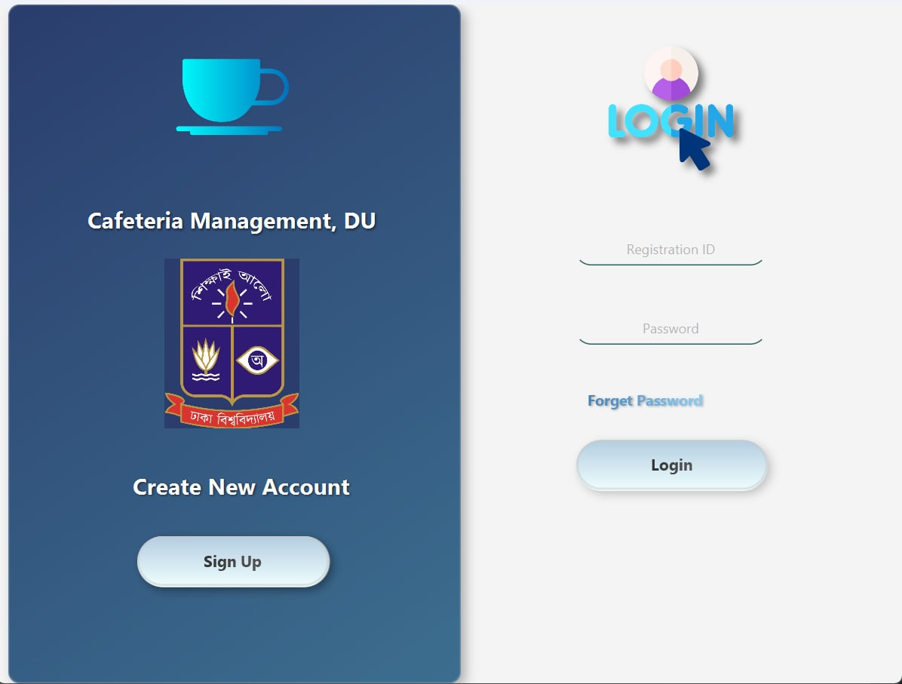
Admin
Login
The admin logs in
usinghis unique id
and password.

Slide 7
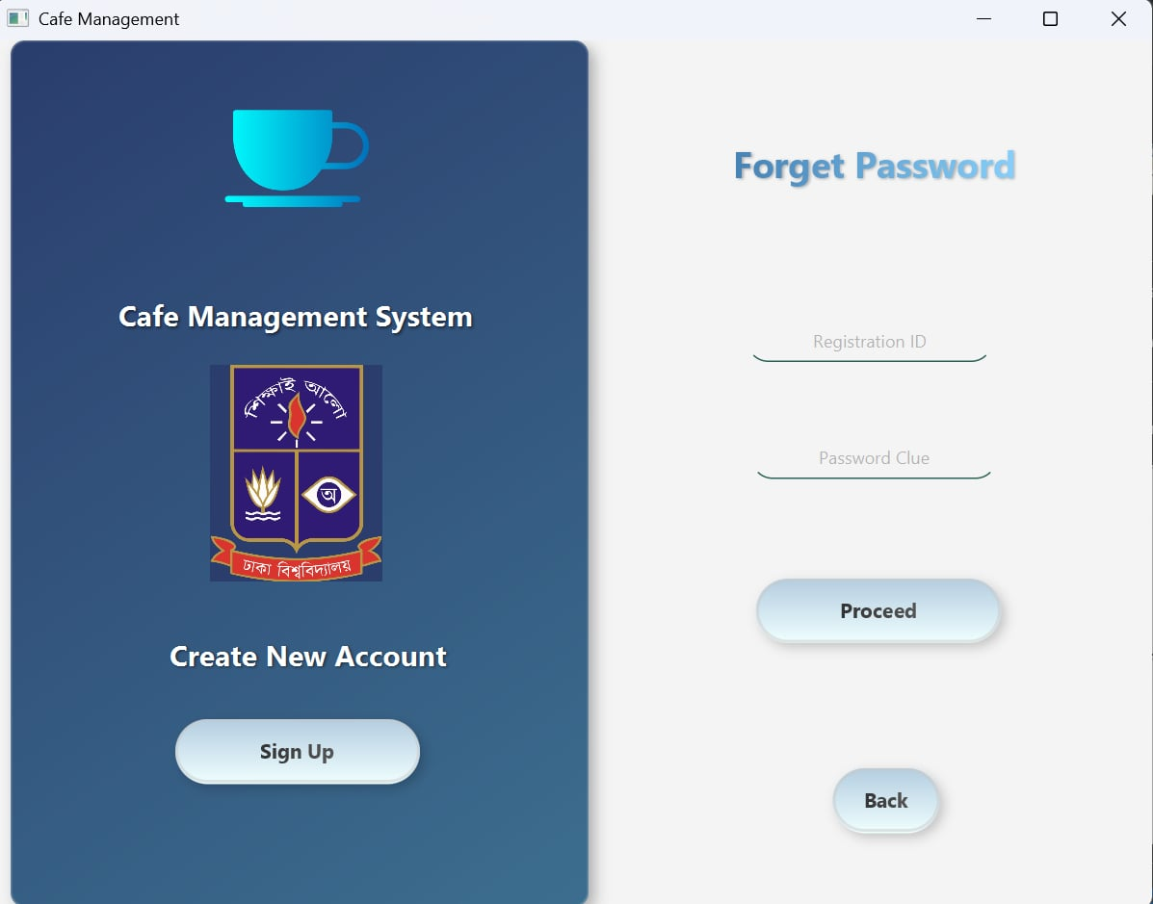

Slide 8
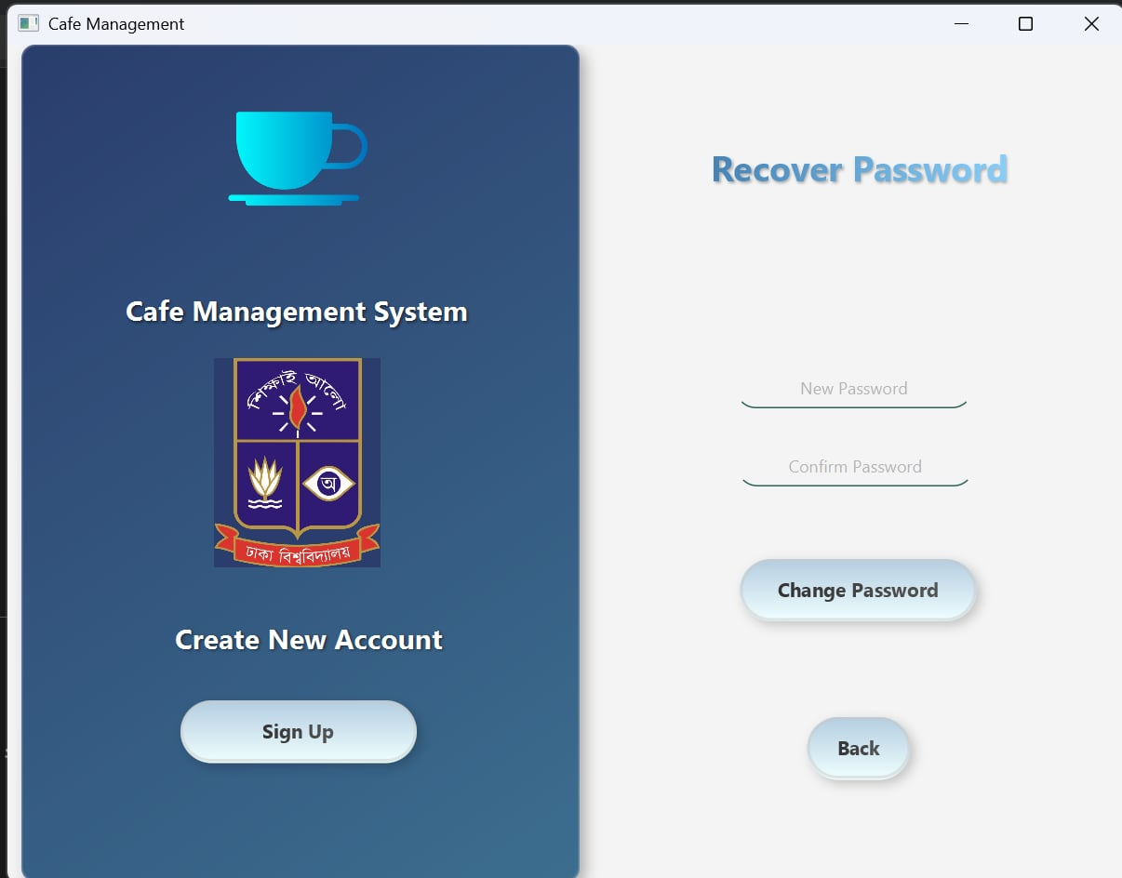

Slide 9
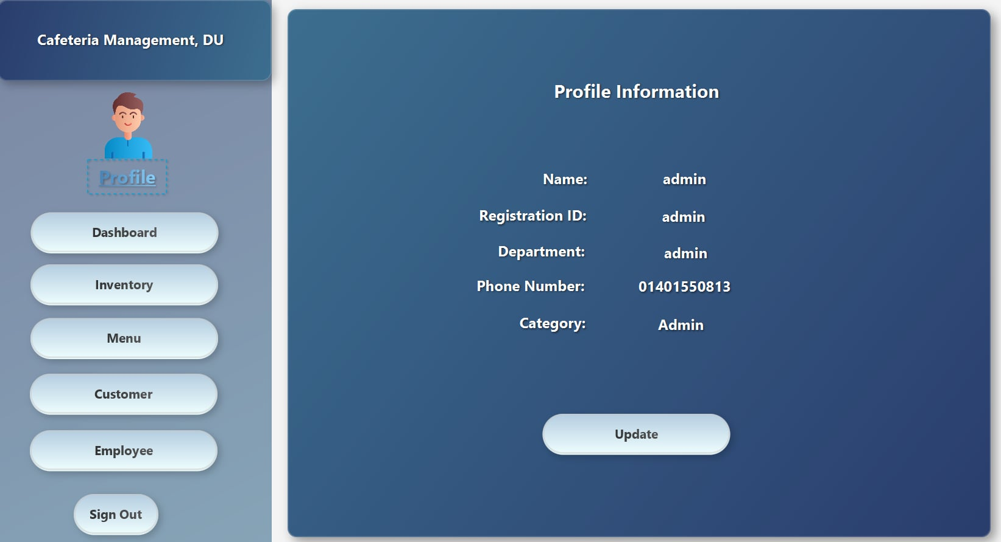
Admin
Profile
Here, admin can see
his profile and update
his information.

Slide 10
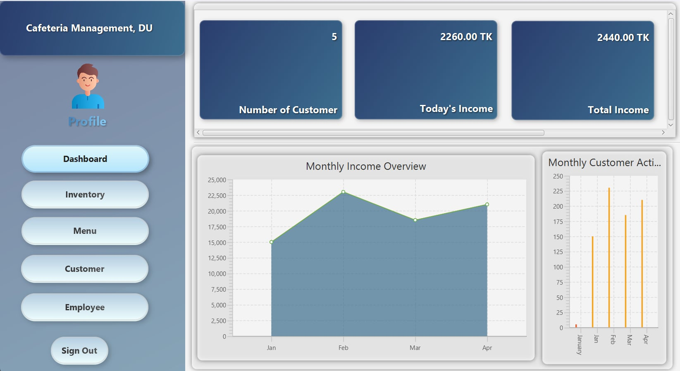
Admin
Dashboard
Admin can see the
number of customers,
today's income, total
income, and the number
of sold products in this
dashboard. He can also
view the income chart
and the customers chart.

Slide 11
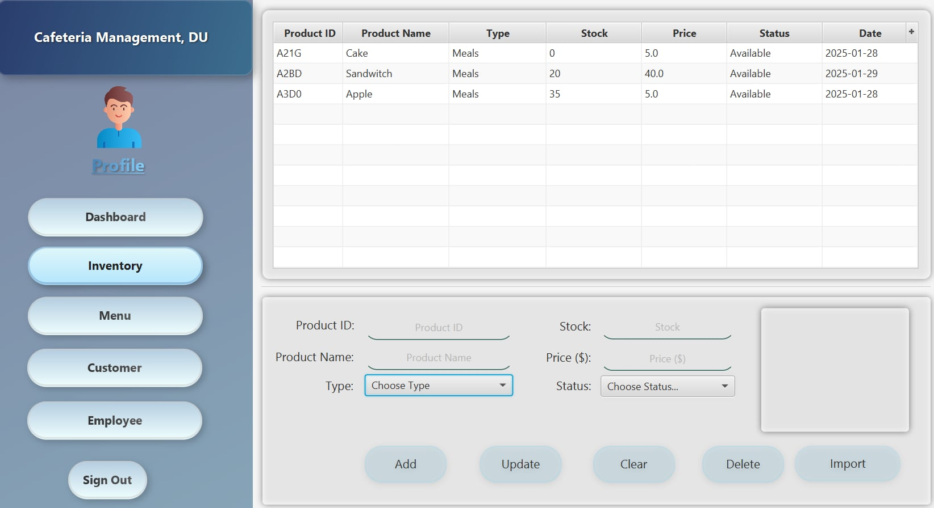
Admin
Inventory
Admin can add
products, check their
availability and
unavailability, update
product information,
and set their prices
here.

Slide 12
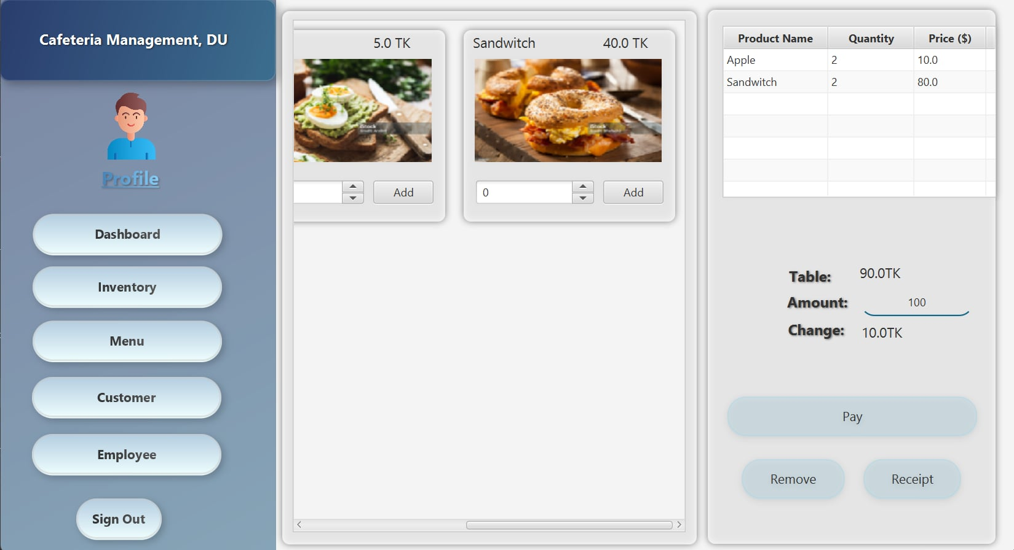
Admin
Menu
The admin can
check different
food items on
this menu page.

Slide 13
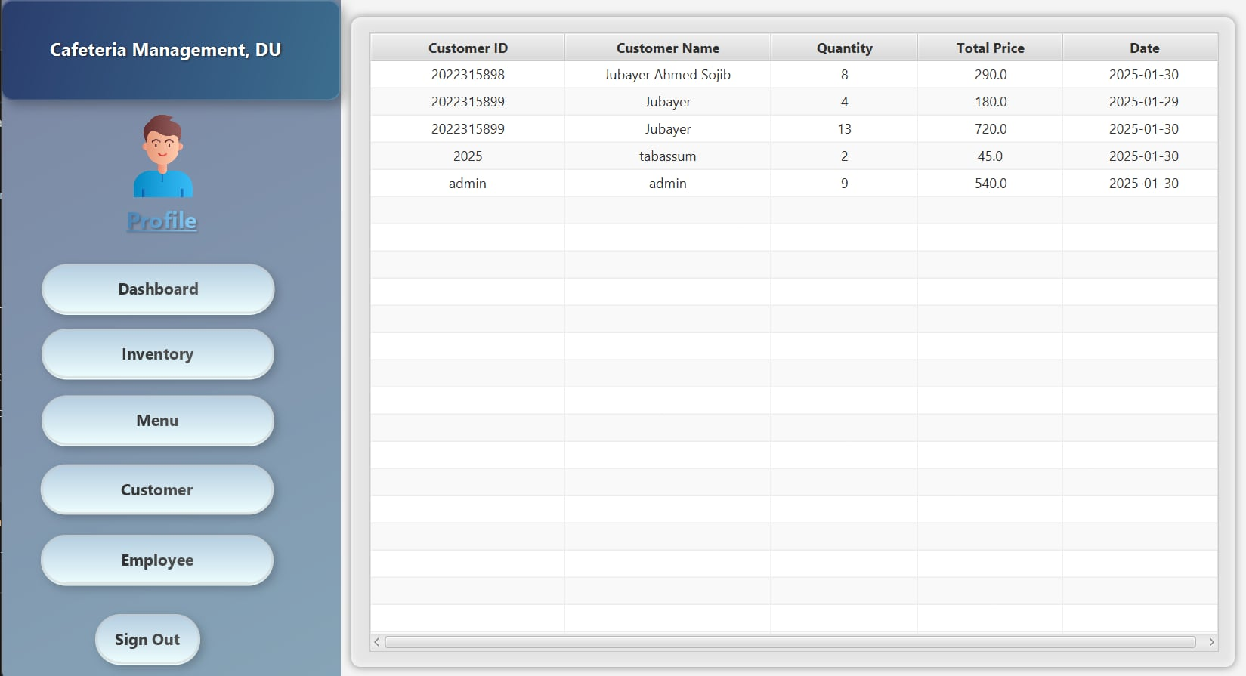
Admin
Customer
The admin can see
the purchase history
on this page and
keep track of the
sold products.

Slide 14
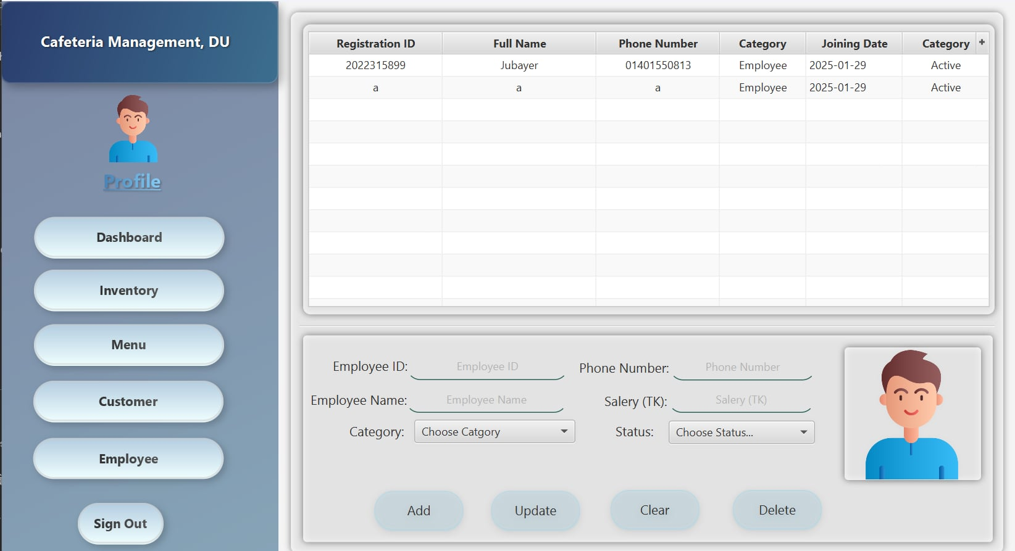
Admin
Employee
The admin can add
employees, view
their categories,
select their salaries,
and confirm their
logins on this page.

Slide 15
UML Diagram
Follow this link:
Github Link
Follow this link:

Slide 16
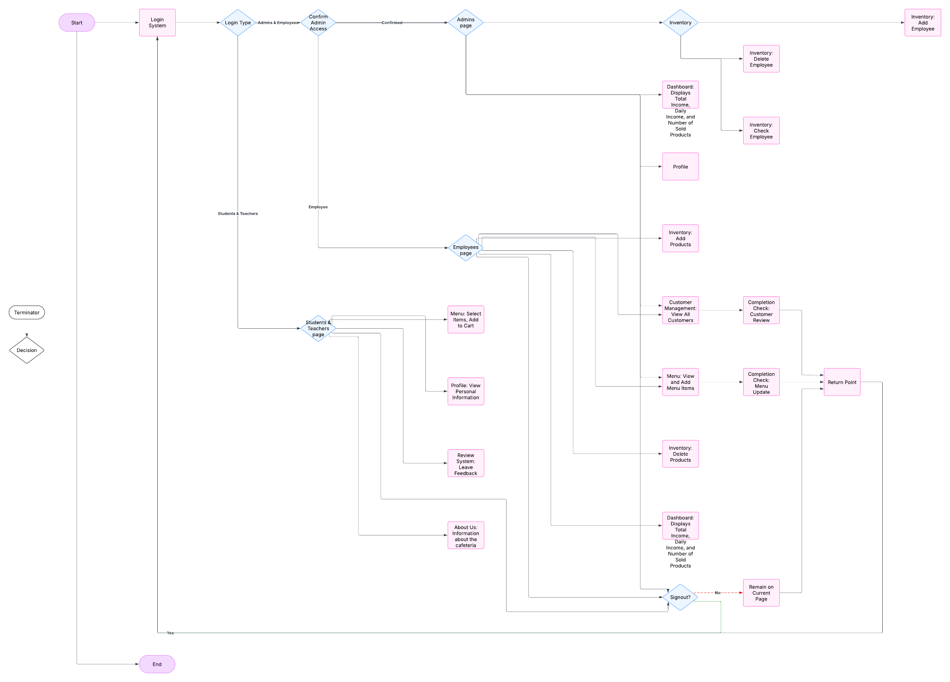

Slide 17
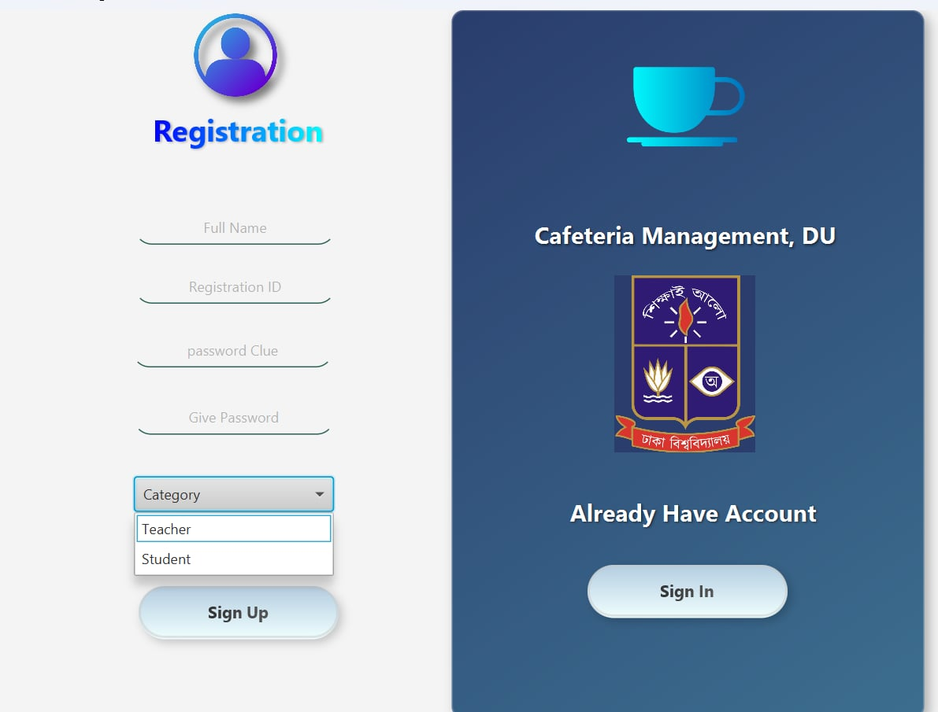
Customer
Login
Customers will log in as either
a student or a teacher with their
registration ID and password
once they have created
an account in this system.

Slide 18
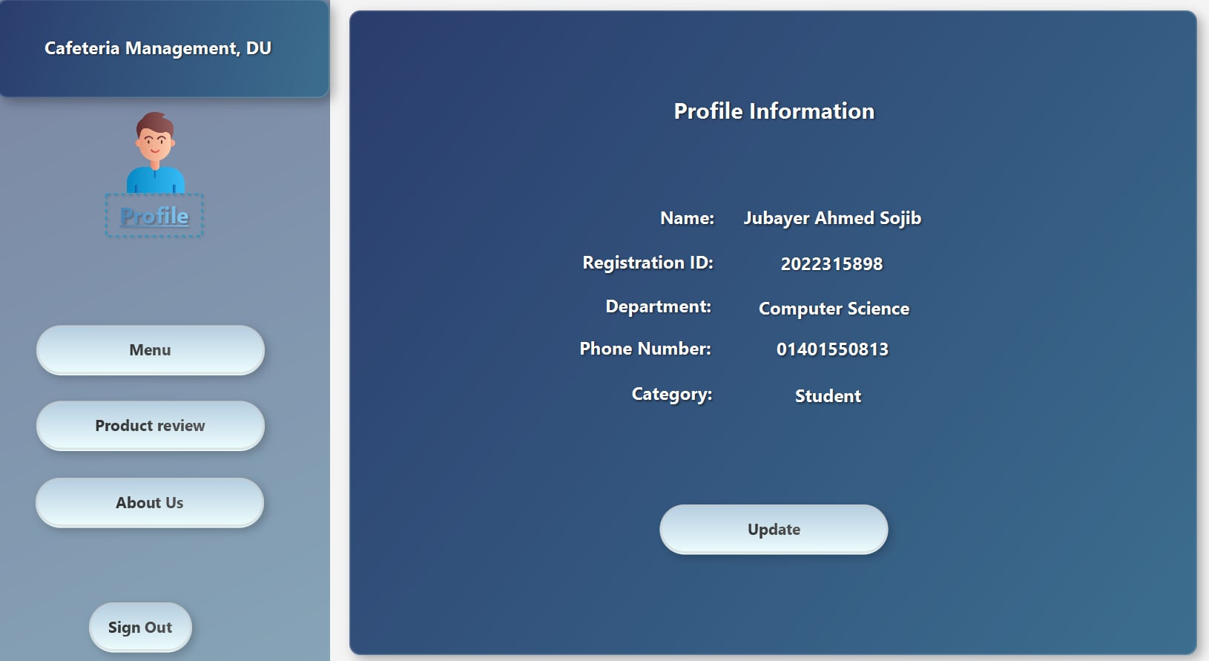
Customer
Profile
Students and
teachers can see
their information
in their profile
and update it.

Slide 19
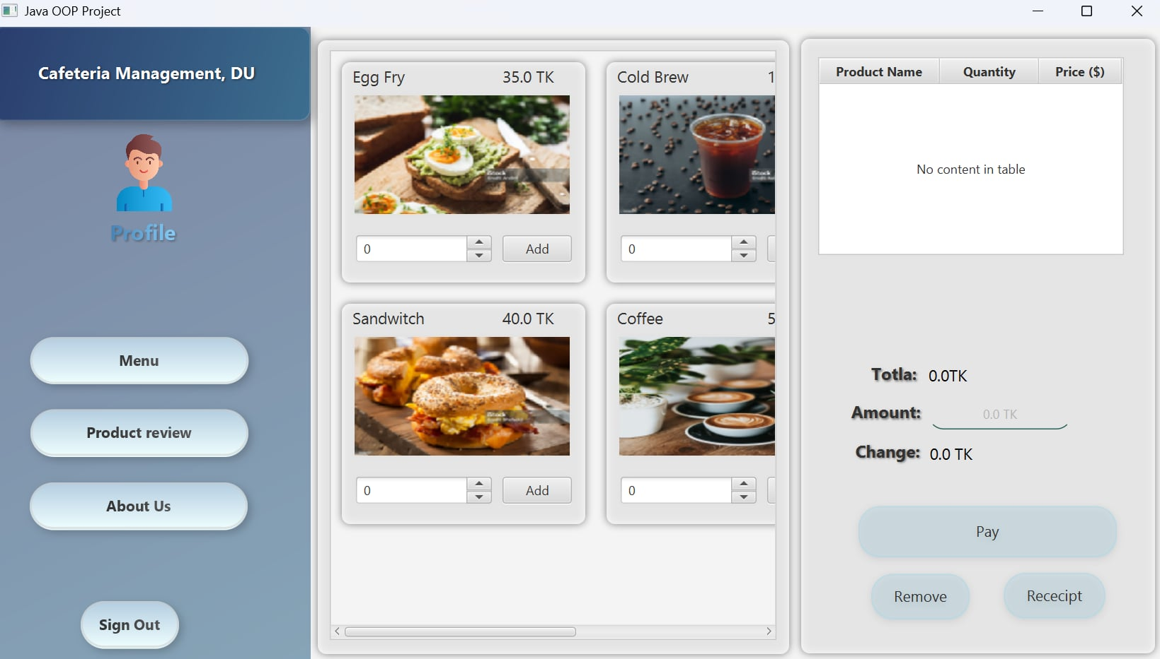
Customer
Menu
Customers can
check the menu
and add items
to their cart.

Slide 20
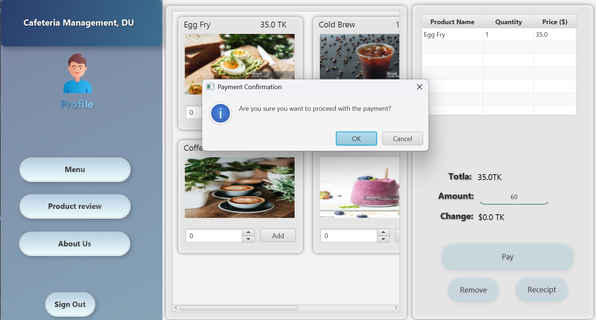
Customer
Payment
A confirmation
will be sent after
payment if you
have sufficient
balance in your
account. The
remaining balance
will then be
calculated.

Slide 21
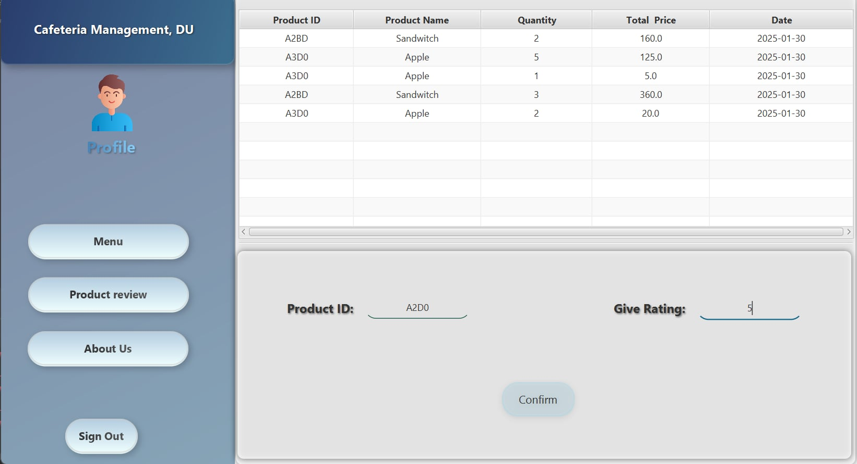
Customer
Product review
Customers can
review the
product as they
wish.

Slide 22
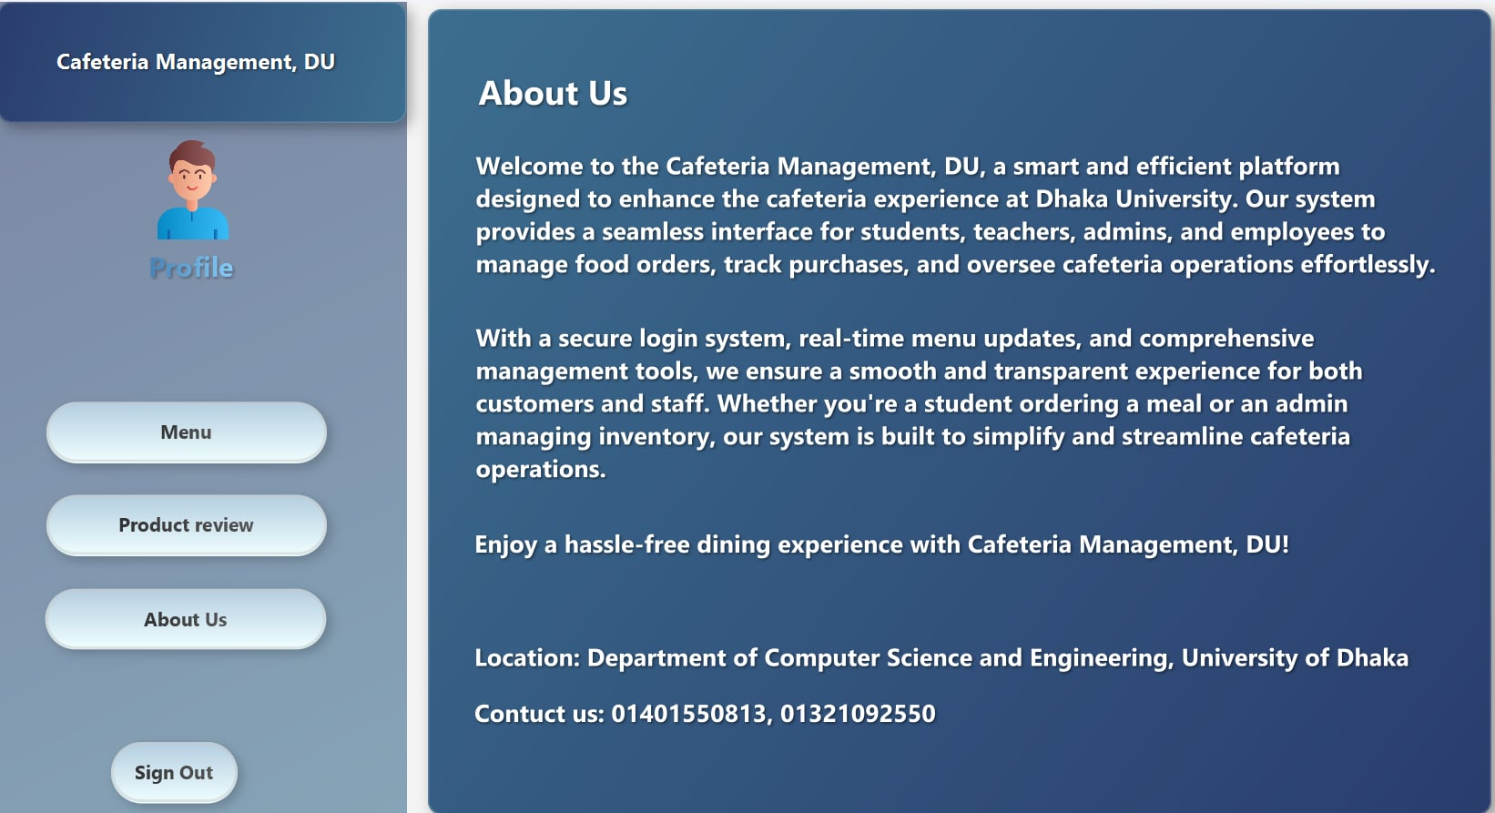
Customer
About Us
Here, customers can
learn about this cafe.
They can view the
location and contact
us via phone.

Slide 23
Employee
Login
Employees can sign in
after the admin confirms
their account. Otherwise,
they must sign up first
and be added to the
system by the admin.

Slide 24
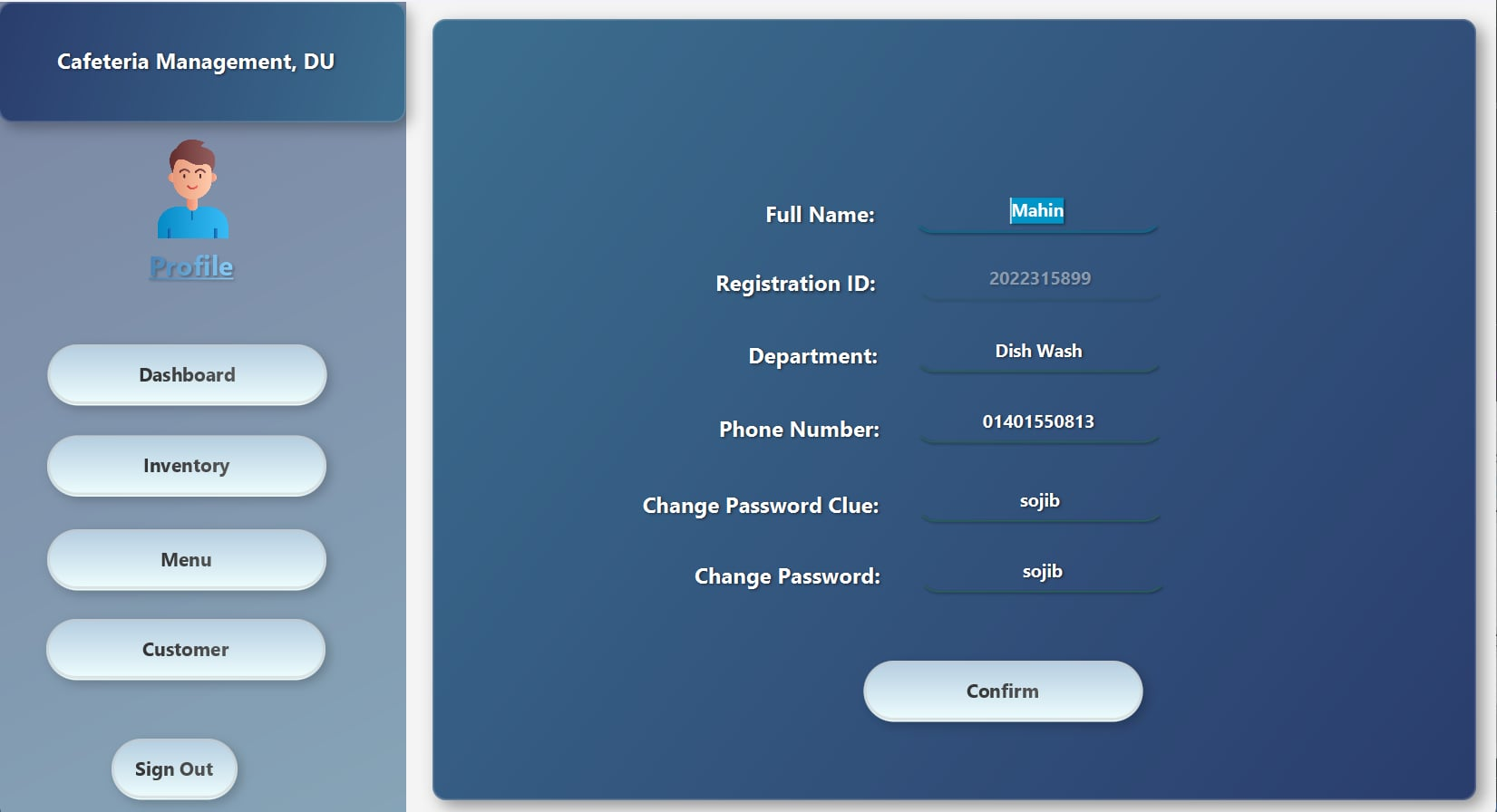
Employee
Profile
They can see
their information
in their profile
and update it
if needed.

Slide 25
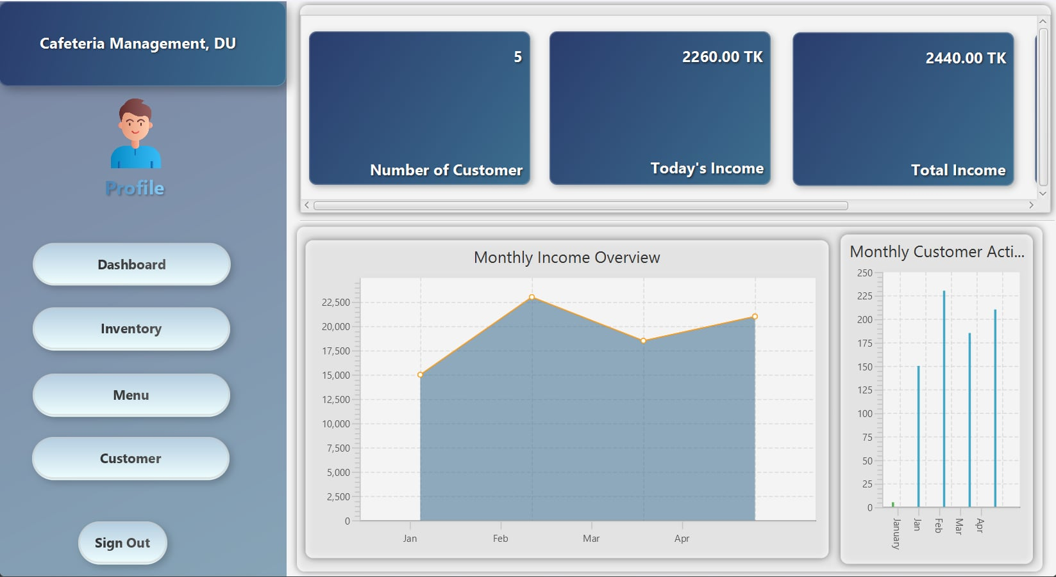
Employee
Dashboard
They can see the
number of customers,
today's income, total
income, and the
number of sold
products in this
dashboard. They
can also view the
income chart and
the customers chart.

Slide 26
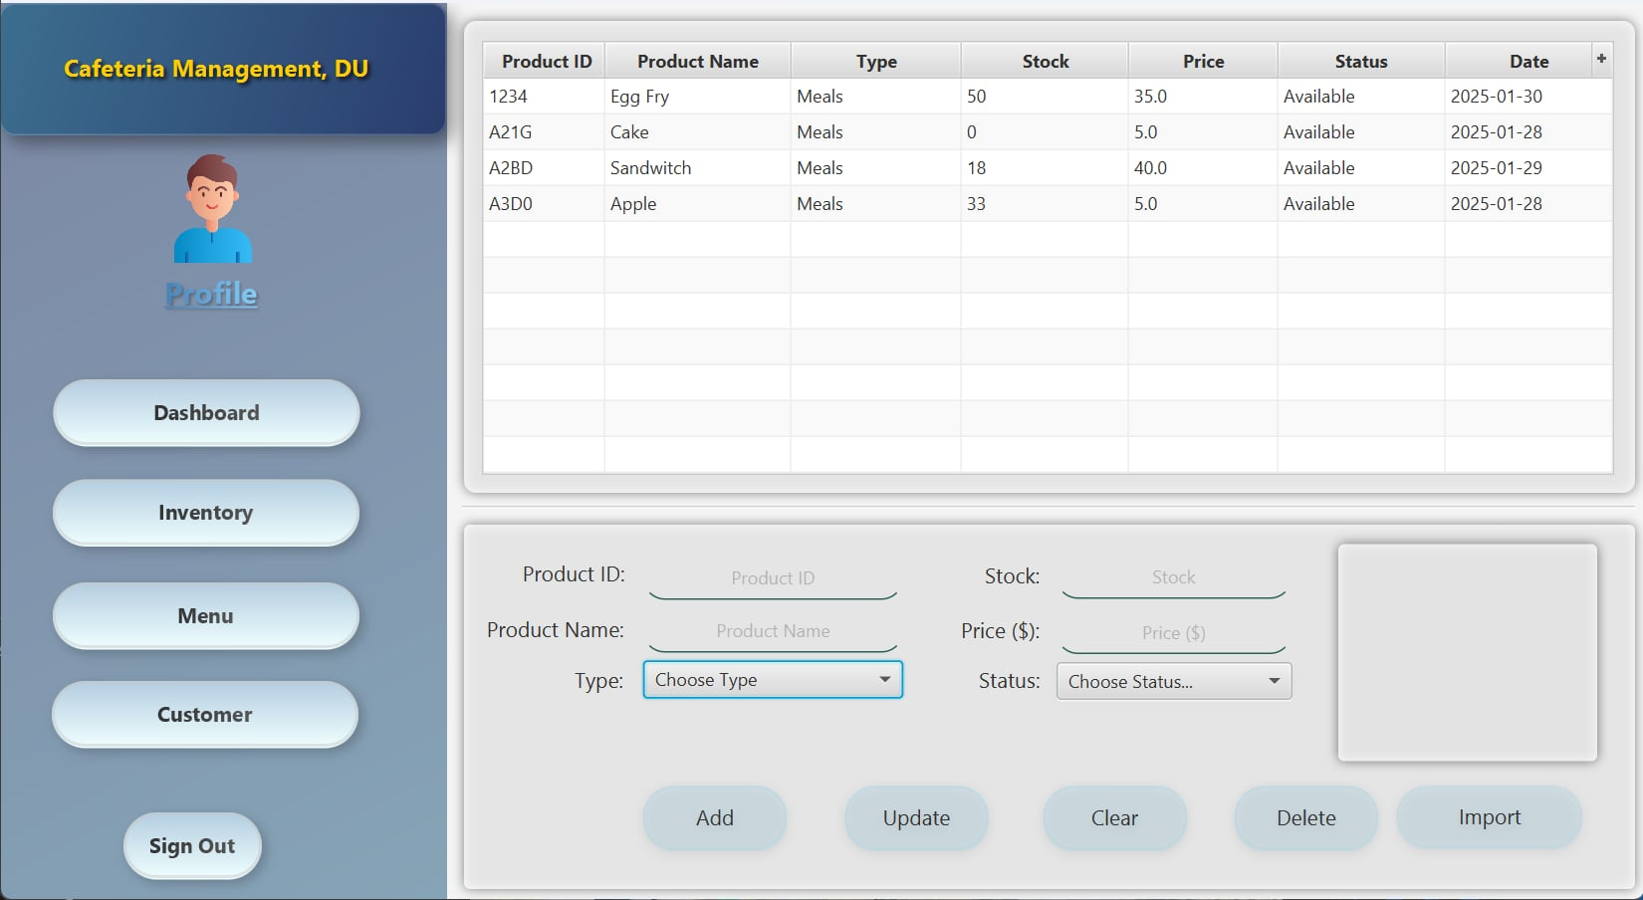
Employee
Inventory
Employees can add
products, check their
availability and
unavailability, update
product information,
and set their prices
here.

Slide 27
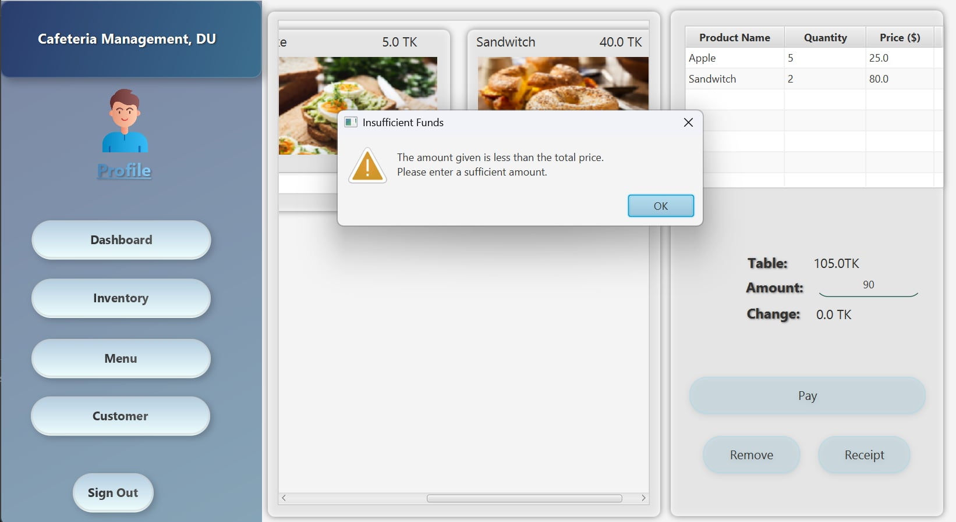
Employee
Menu
Employees can
check food items
here after updating
them on the
inventory page.

Slide 28
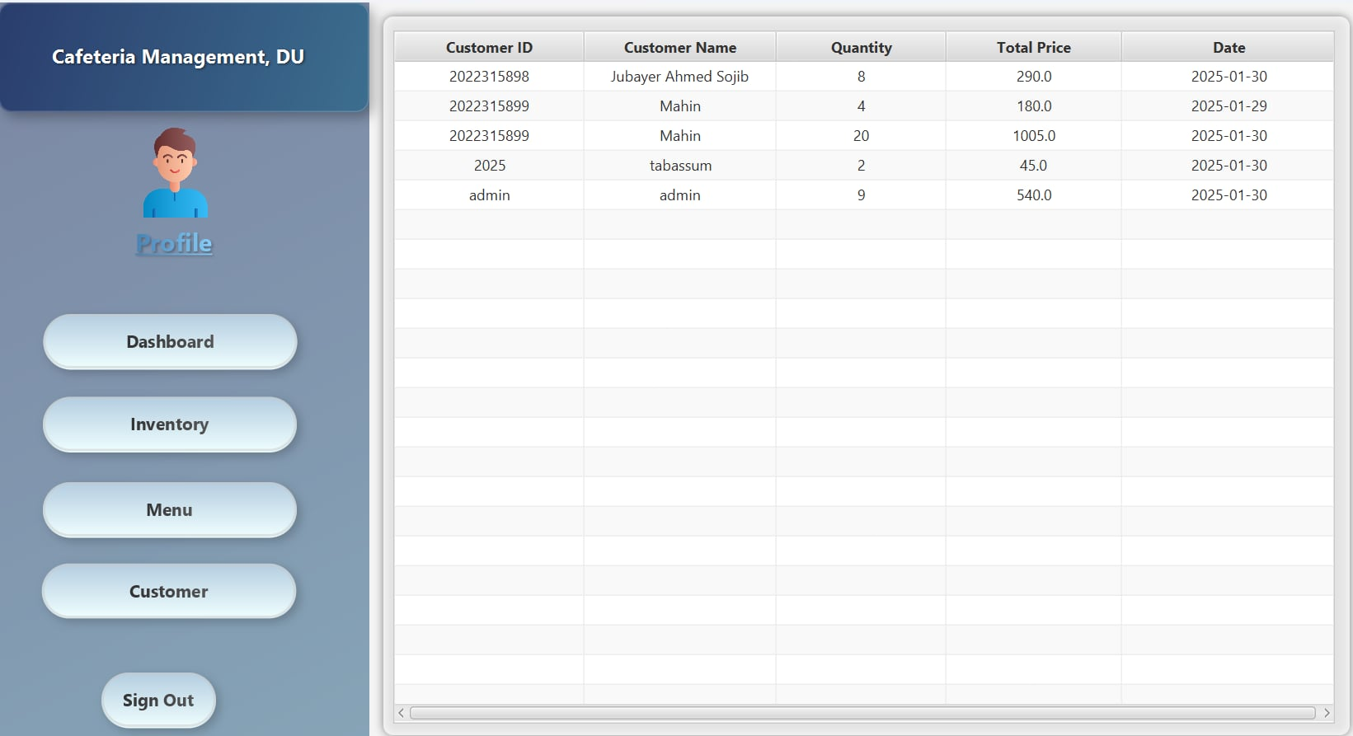
Employee
Customer
Employees can
see which
customers bought
which products in
order to keep
track of the
products.

Slide 29
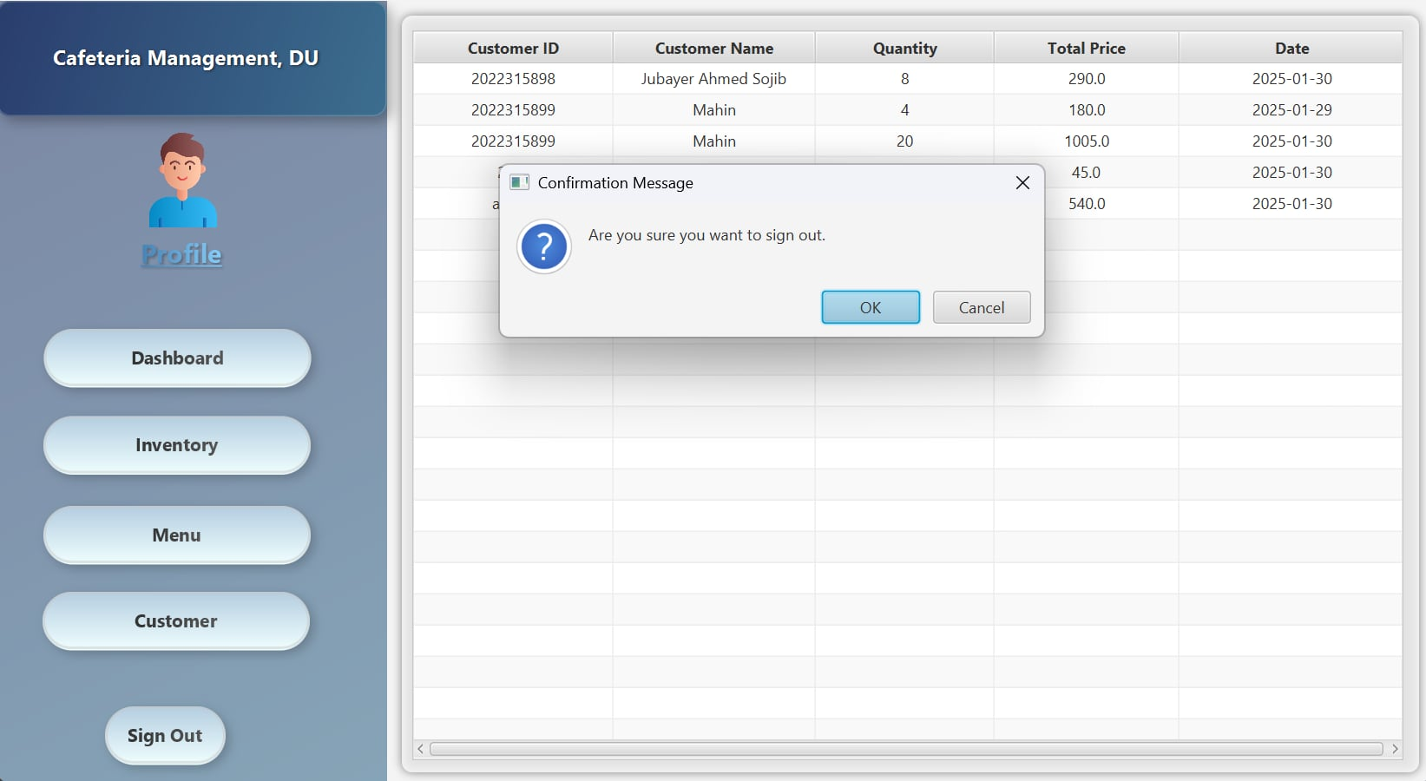
Sign Out

Slide 30
Implementation of OOP and Design Principles
Our Cafeteria Management, DU is built using Object-Oriented Programming (OOP) principles to ensure scalability, maintainability, and modularity.
Encapsulation: User data, menu items, and transactions are securely managed through well-defined classes with restricted access.
Inheritance: The system follows a structured hierarchy, where Admin, Employee, Teacher, and Student inherit common attributes from a User superclass.
Polymorphism: Different user types interact with the system through a unified interface while performing distinct roles.
Abstraction: Complex operations like order processing, authentication, and data retrieval are encapsulated within specialized classes, simplifying implementation.
Additionally, we followed SOLID design principles, ensuring single-responsibility for each class, modularity, and flexibility for future enhancements. Our approach not only optimized performance but also improved code reusability and security.

Slide 31
Conclusion
In the early stages, we aimed to develop a complete cafe management system that would provide both the admin and customer panels with an easy and reliable platform. However, it is currently limited to one café in DU. Despite this, we have applied our OOP knowledge and refined our software design skills, tackling real-world challenges and devising solutions along the way.

Slide 32
Thank You

